Slide 1

Sinhgad Technical Education Society’s
SINHGAD COLLEGE OF ENGINEERING, Pune-41
Department of Information Technology
Project Review - I
Presented By
Asmita Nalawade
Shraddha Agre
Shubham Malpure
Swapnil Bhalerao
Guided By
Prof.J.S.Kulkarni

Slide 2
Project Title
Disease Prediction Using ML

Slide 3
Problem Statement
To develop and implement a model which takes symptoms as input. On the basis of that it predicts which disease the patient is having.
Input :
Symptoms in the form of text.
Output :
Report in the form of dashboard .
Health Status of User.

Slide 4
Motivation
The COVID-19 has a high growth rate with incomplete knowledge about the transmission of virus.
The patient may be symptomatic or asymptomatic.
Due to this if the virus is not detected early it may spread widely.
So, we've came with a solution where we're using a AI based model using Image Captioning and ML for progressive detection of COVID-19 cases

Slide 5
Purpose
Need to get accurate insights from image so that it can be used for any specified purpose.
There is need for accurate & rapid detection of COVID cases in order to control virus spread.
The existing RT-PCR tests are only 50% efficient with significant False negatives and False positives.
So AI Based system is required to detect covid cases

Slide 6
Scope
Model used to generate accurate prediction of disease.
Responsive test field to take symptoms from user
An informative dashboard to get proper status of user health.

Slide 7
Objectives
To implement ML based Algorithm to detect accurate disease based on symptoms.
To Predict disease using symptoms (Data Mining).
To generate detailed dashboard of user disease status
To Design web app for above system.

Slide 8
Introduction of the Project
The technique of detecting and recognising the objects using deep learning is mainly used to generate captions.
COVID-19 has become a global pandemic with an exponential growth rate and an incompletely understood transmission process.
A CT Scan reports play a vital role in this situation as, on the basics of CT Scan reports one can predict the start of covid-19.
In this approach of detecting covid-19 , A CT Scan image is given as an input and then the relevant output is being provided.
We present a novel approach to detect covid using Image captioning and Machine Learning.

Slide 9
Domain
Machine Learning
Deep Learning

Slide 10
Abstract
Now-a-days, people face various diseases due to the environmental condition and their living habits. So the prediction of disease at earlier stage becomes important task. But the accurate prediction on the basis of symptoms becomes too difficult for doctor. The correct prediction of disease is the most challenging task. To overcome this problem data mining plays an important role to predict the disease. Medical science has large amount of data growth per year. Due to increase amount of data growth in medical and healthcare field the accurate analysis on medical data which has been benefits from early patient care. With the help of disease data, data mining finds hidden pattern information in the huge amount of medical data. We proposed general disease prediction based on symptoms of the patient.

Slide 11
For the disease prediction, we use K-Nearest Neighbor (KNN) and Convolutional neural network (CNN) machine learning algorithm for accurate prediction of disease. For disease prediction required disease symptoms dataset. In this general disease prediction the living habits of person and checkup information consider for the accurate prediction. The accuracy of general disease prediction by using CNN is 84.5% which is more than KNN algorithm. And the time and the memory requirement is also more in KNN than CNN. After general disease prediction, this system able to gives the risk associated with general disease which is lower risk of general disease or higher.

Slide 12
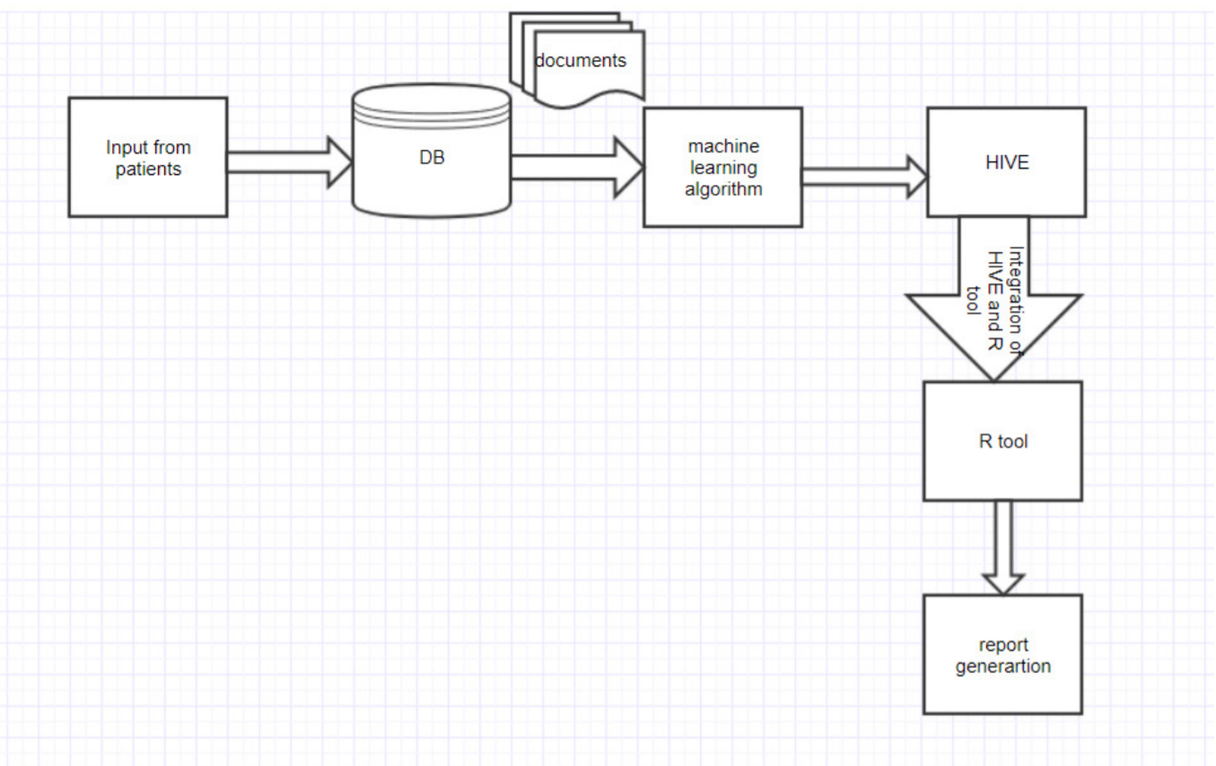
Flow Chart

Slide 13
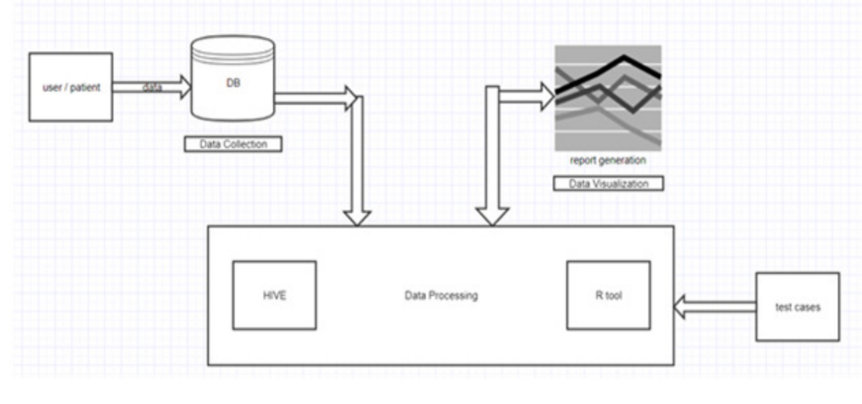
Architecture Design

Slide 14
Literature Survey
Author | Title of the Paper | Concentration
Stephanie A. Harmon | Artificial intelligence for the detection of COVID-19 pneumonia on chest CT Scan using multinational datasets (2020) | This paper aims to develop and evaluate an AI algorithm for the detection of COVID-19 on chest CT using data from a globally diverse, multi-institution dataset. Here we show robust models can be achieve up to 90% accuracy in independent test populations, maintaining high specificity in non-COVID-19 related pneumonias, and demonstrating sufficient generalizability to unseen patient populations/centers. Lung segmentation model. lung segmentation model was trained using the AH-Net architecture Image classification model. Both the hybrid 3D and full 3D models used in this study were based on a Densnet-121 architecture adapted to utilize 3D operations (i.e., 3D convolutions) compared to original 2D implementation.

Slide 15
Literature Survey
Author | Title of the Paper | Concentration
 |  | Data augmentation was performed to avoid bias of center-specific characteristics, and included image intensity and contrast adjustment, introduction of random gaussian noise, flipping, and rotation. Within each mini batch, data were sampled to ensure class balance between COVID and non-COVID groups. Statistical analysis. Classification performance was evaluated by overall accuracy, positive predictive value, negative predictive value, sensitivity, and specificity for correctly distinguishing between COVID-19 vs. any other condition. Summary statistics of false positive predictions (incorrectly labeling as COVID-19) were reported separately for pneumonia cohorts and all-comer/any-indication cohorts. They have used CNN based approach to predict covid using CT image dataset. This system claims accuracy above 90%.

Slide 16
Literature Survey
Author | Title of the Paper | Concentration
Feixiang Huang, Shengyong Wang, and Chien-Chung Chan | Predicting Disease By Using Data Mining Based on Healthcare Information System | In this paper, their focus on data mining is to extract hidden rules and relationships between diseases from a real world Healthcare Information System. Information of pathological indices is not used in our work. Only the information of presence or absence of diseases in patient medical records is applied. In this the disease prediction was done by using medical profiles such as cholesterol level, blood sugar, blood pressure and so on. In contrast, their method is to predict a disease based on other diseases that a patient already has. One benefit of their approach is that it can be applied to predict any disease rather than a specific disease. In this paper they have used NLP based algorithm to predict any disease using input text. User will be providing symptoms as text.

Slide 17
Literature Survey
Author | Title of the Paper | Concentration
Chetan Amritkar, Vaishali Jabade | Image Caption Generation using Deep Learning Technique | This paper proposes a model capable of generating novel descriptions from images. For this task, they have used Flickr 8k dataset consisting of 8000 images and five descriptions per image. In this work, they are using CNN as well as RNN. Pre-trained Convolutional Neural Network (CNN) is used for the image classification task. This network acts as an image encoder. The last hidden layer is used as an input to Recurrent Neural Network (RNN). This network is a decoder which generates sentences. Sometimes, the generated sentence seems to lose track or predict wrong sentence than that of the original image content. This sentence is generated from description that is common in dataset and the sentence is weakly related to input image.

Slide 18
Application
Caption Generation
Disease Detection

Slide 19
References
[1] P. S. Kohli and S. Arora, "Application of Machine Learning in Disease Prediction," 2018 4th International Conference on Computing Communication and Automation (ICCCA), Greater Noida, India, 2018, pp. 1-4, doi: 10.1109/CCAA.2018.8777449.
[2] D. Dahiwade, G. Patle and E. Meshram, "Designing Disease Prediction Model Using Machine Learning Approach," 2019 3rd International Conference on Computing Methodologies and Communication (ICCMC), Erode, India, 2019, pp. 1211-1215, doi: 10.1109/ICCMC.2019.8819782.
[3] S. Patel and H. Patel, “Survey of data mining techniques used in healthcare domain,” Int. J. of Inform. Sci. and Tech., Vol. 6, pp. 53-60,March 2016.

